Slide 1
GPS2-mediated retrograde signaling and the mtUPR pathway - mediated by ATF3, ATF4 and ATF5
07/12/2024
Jawahar Mahendran

Slide 2
Mitochondrial-Nuclear Coordination and GPS2 Role
Mitochondria contain their own DNA but rely on nuclear genes.
Coordination between mitochondrial and nuclear genomes is crucial for cellular homeostasis. Nucleus → Mitochondria : Anterograde Mitochondria → Nucleus : Retrograde
GPS2 - key mediator of retrograde signaling.
GPS2 is also known to interact with multiple Transcription factors and cofactors.

Slide 3
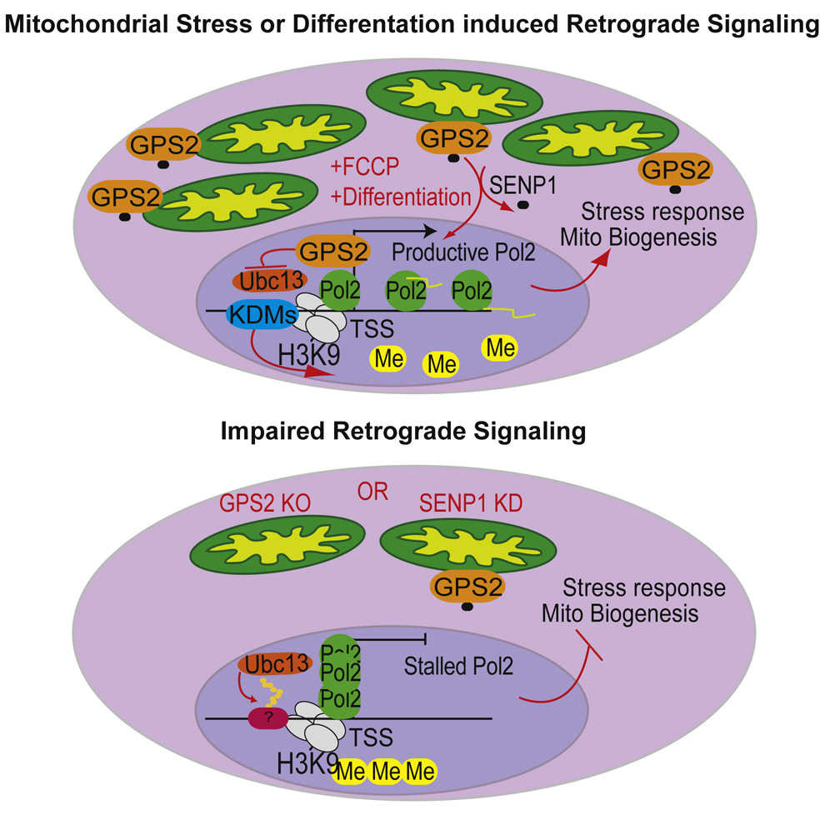
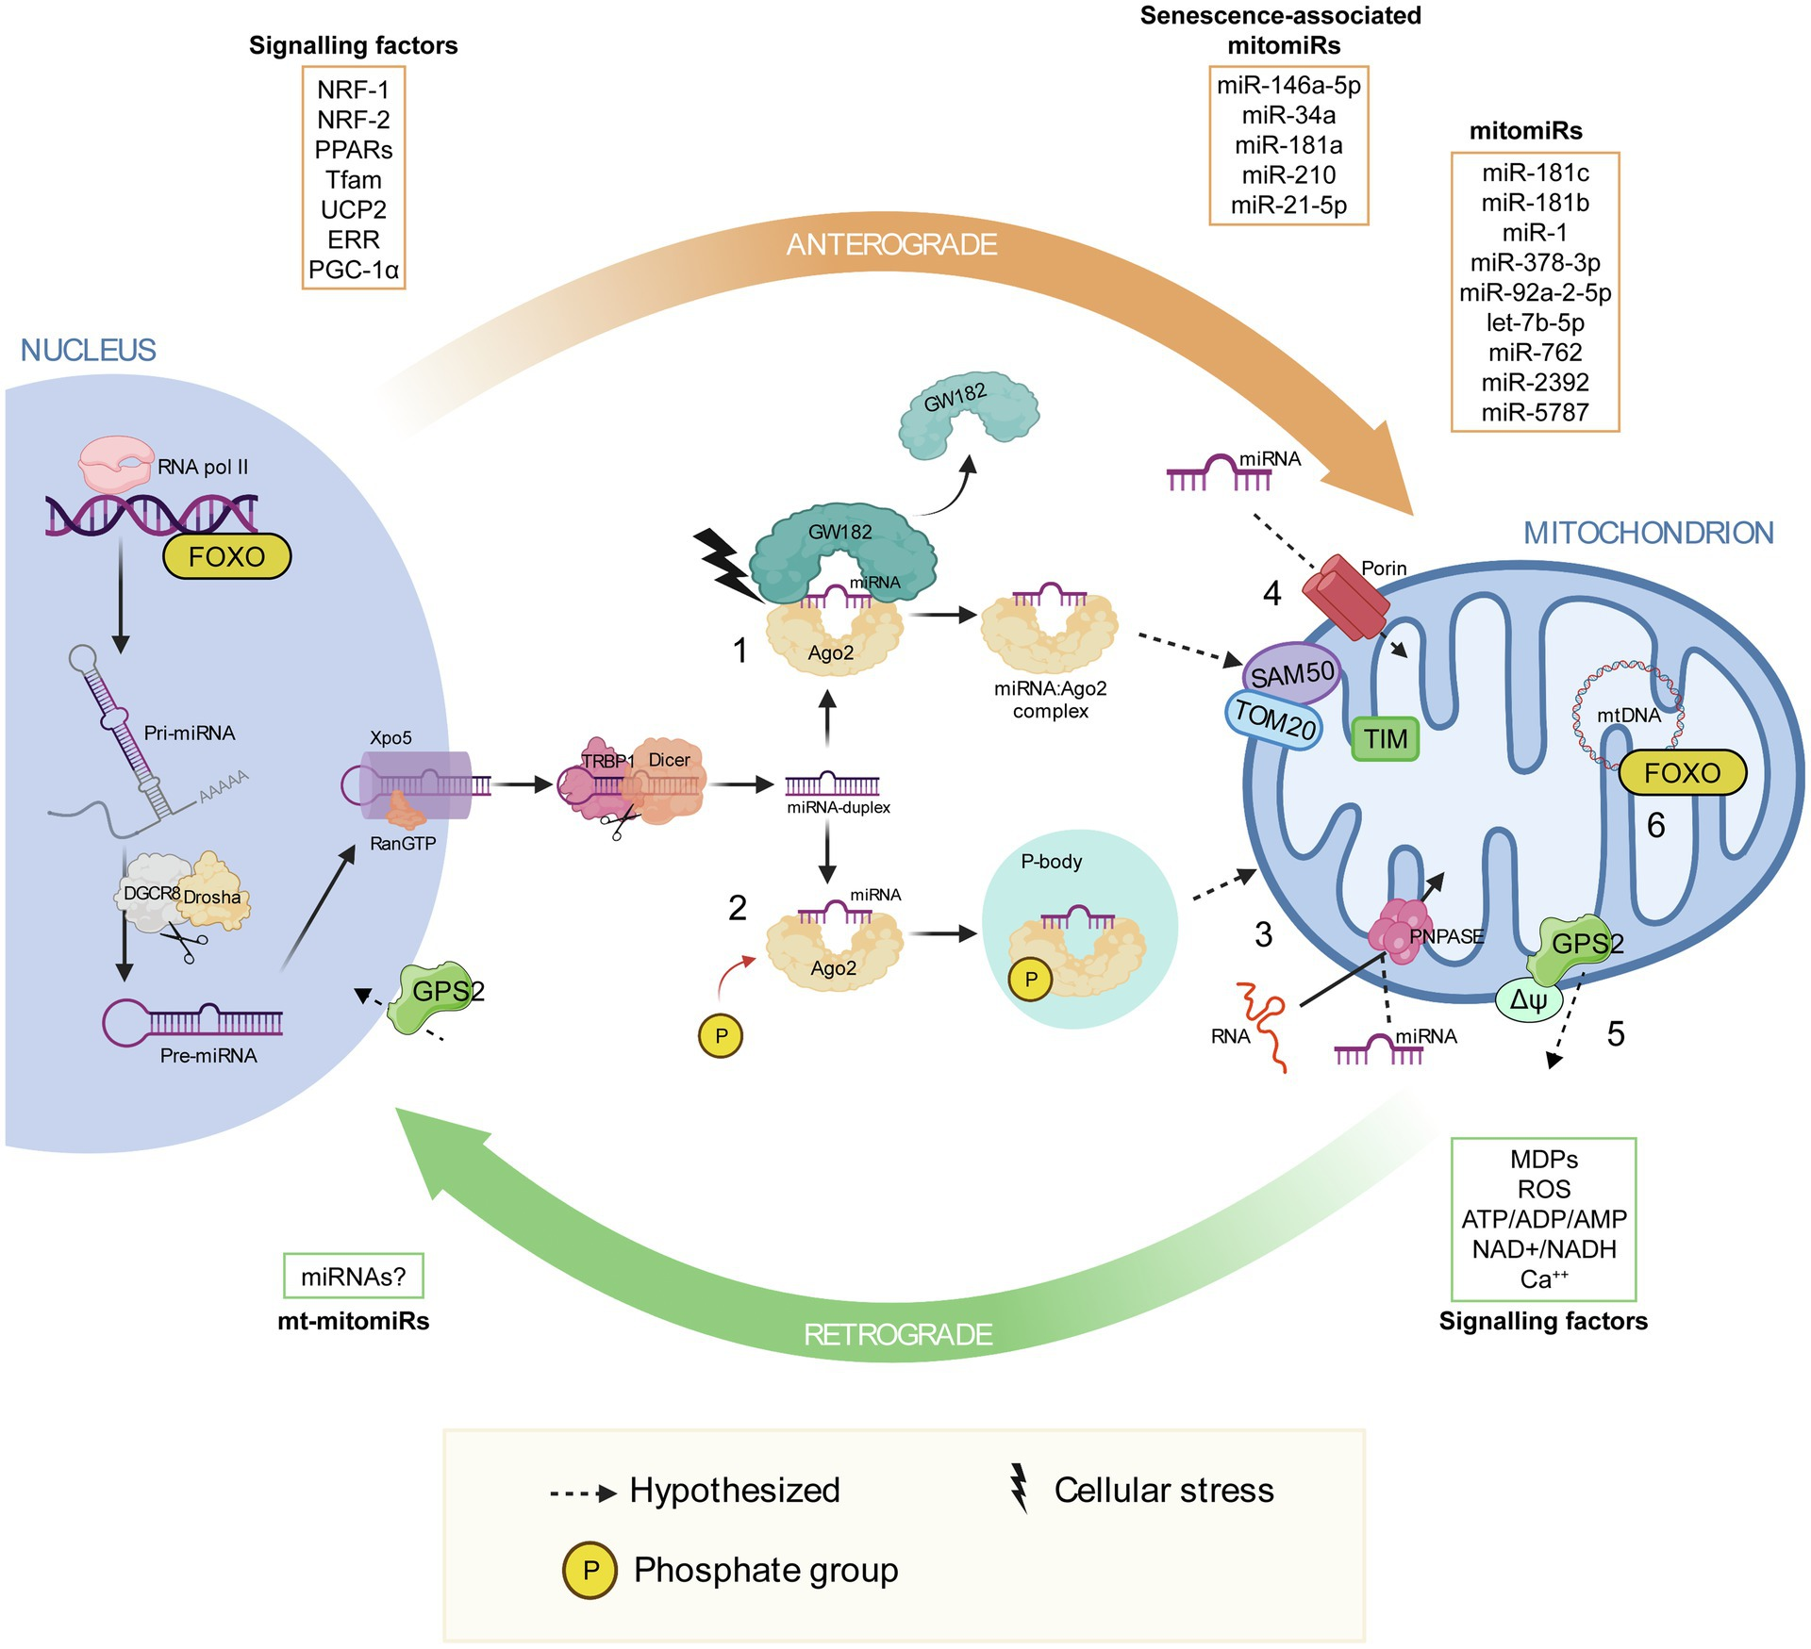
Giordani, C., Silvestrini, A., Giuliani, A., Olivieri, F., & Rippo, M. R. (2021, August 12). MicroRNAs as factors in bidirectional crosstalk between mitochondria and the nucleus during cellular senescence. Frontiers. https://www.frontiersin.org/journals/physiology/articles/10.3389/fphys.2021.734976/full
Cardamone, M. D., Tanasa, B., Cederquist, C. T., Huang, J., Mahdaviani, K., Li, W., Rosenfeld, M. G., Liesa, M., & Perissi, V. (2018). Mitochondrial Retrograde Signaling in Mammals Is Mediated by the Transcriptional Cofactor GPS2 via Direct Mitochondria-to-Nucleus Translocation. Molecular cell, 69(5), 757–772.e7. https://doi.org/10.1016/j.molcel.2018.01.037

Slide 4
Understanding GPS2 Target Gene Recruitment
What are the specific target genes that GPS2 binds to?
How it gets recruited to specific target genes in response to retrograde translocation from stressed mitochondria?
What are the molecular mechanisms in play?

Slide 5
GPS2 Interaction with ATF4/ATF5
GPS2 is recruited to a subset of nuclear stress response genes through its interaction with ATF4/ATF5.
ATF4/5 target genes were found among the DEGs regulated by GPS2.
Direct interaction between ATF4 and GPS2 is reported in BioGRID and was validated by co-immunoprecipitation.
Preliminary overlap between GPS2 target genes and ATF3/ATF4/5-bound genes listed in ChIP-ATLAS

Slide 6
ChIP-seq Data Sources
GPS2 ChIP-seq data from murine 3T3-L1 adipocytes (in-house)
ATF3/ATF4/ATF5 ChIP-seq data from published resources

Slide 7
Workflow
.fastq files from GEO
Quality Control using FastQC
Adapter trimming using Trimmomatic
Alignment using Bowtie2
Sorting and indexing using samtools
Peak calling using macs3
Peak annotation using ChIP-seeker
Motif calling using HOMER
All of these steps were made into a pipeline using snakemake

Slide 8
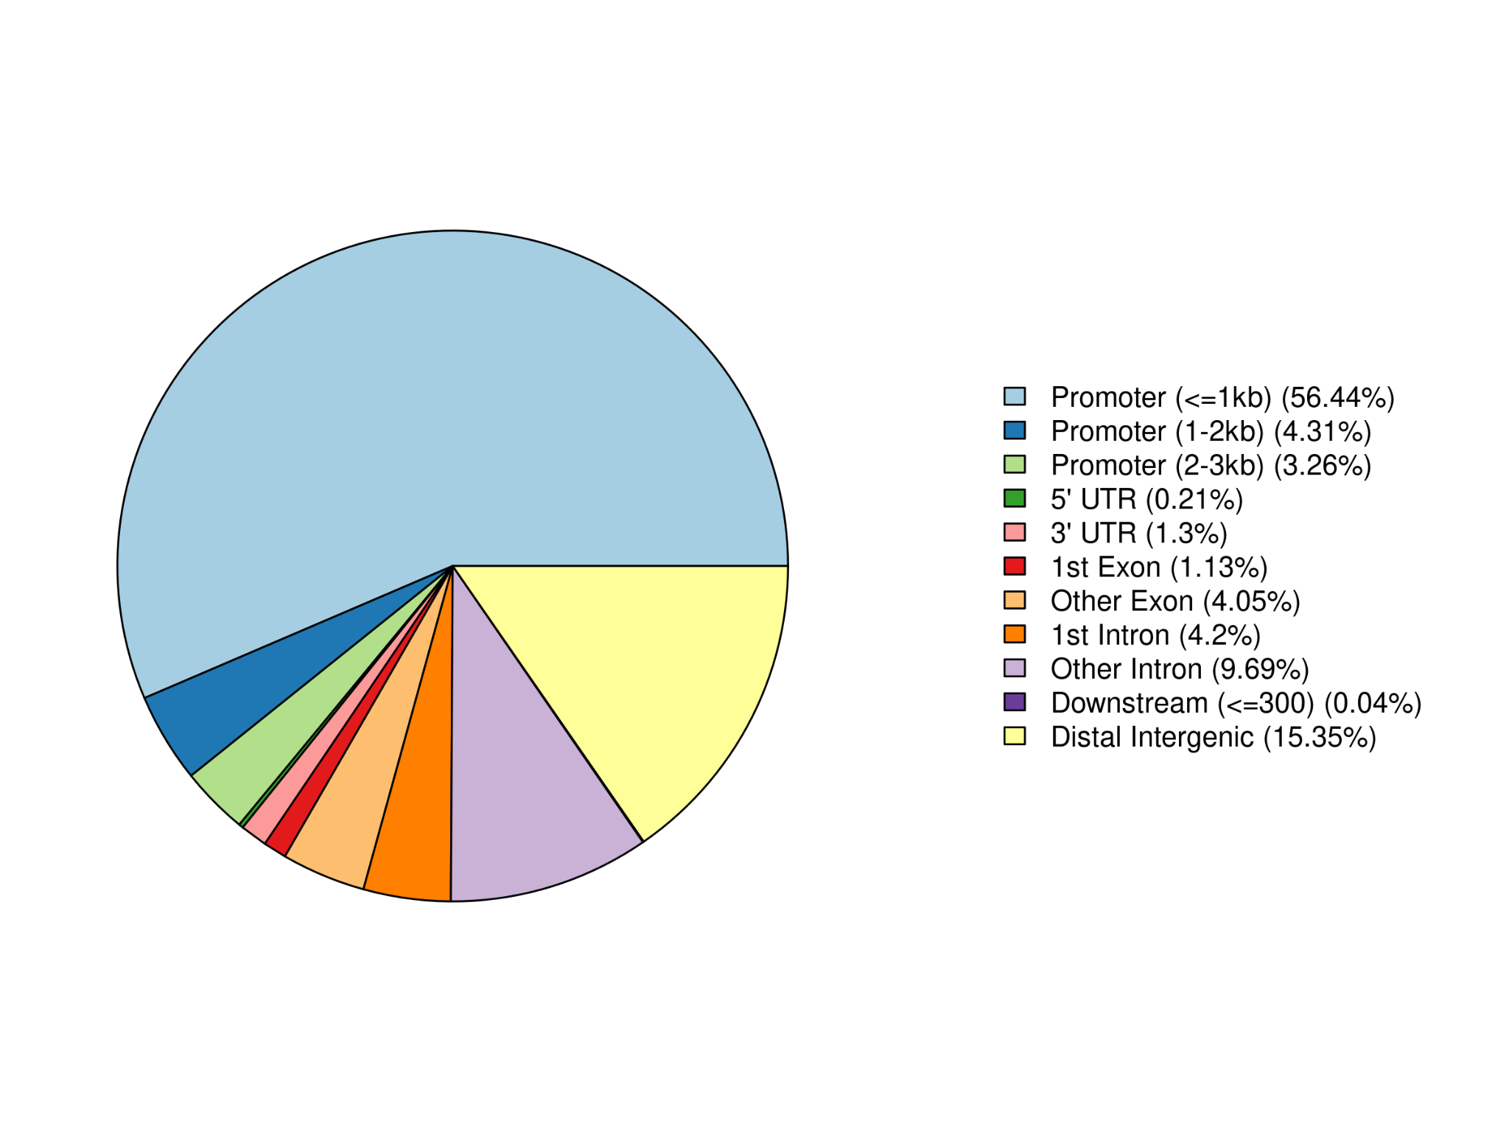
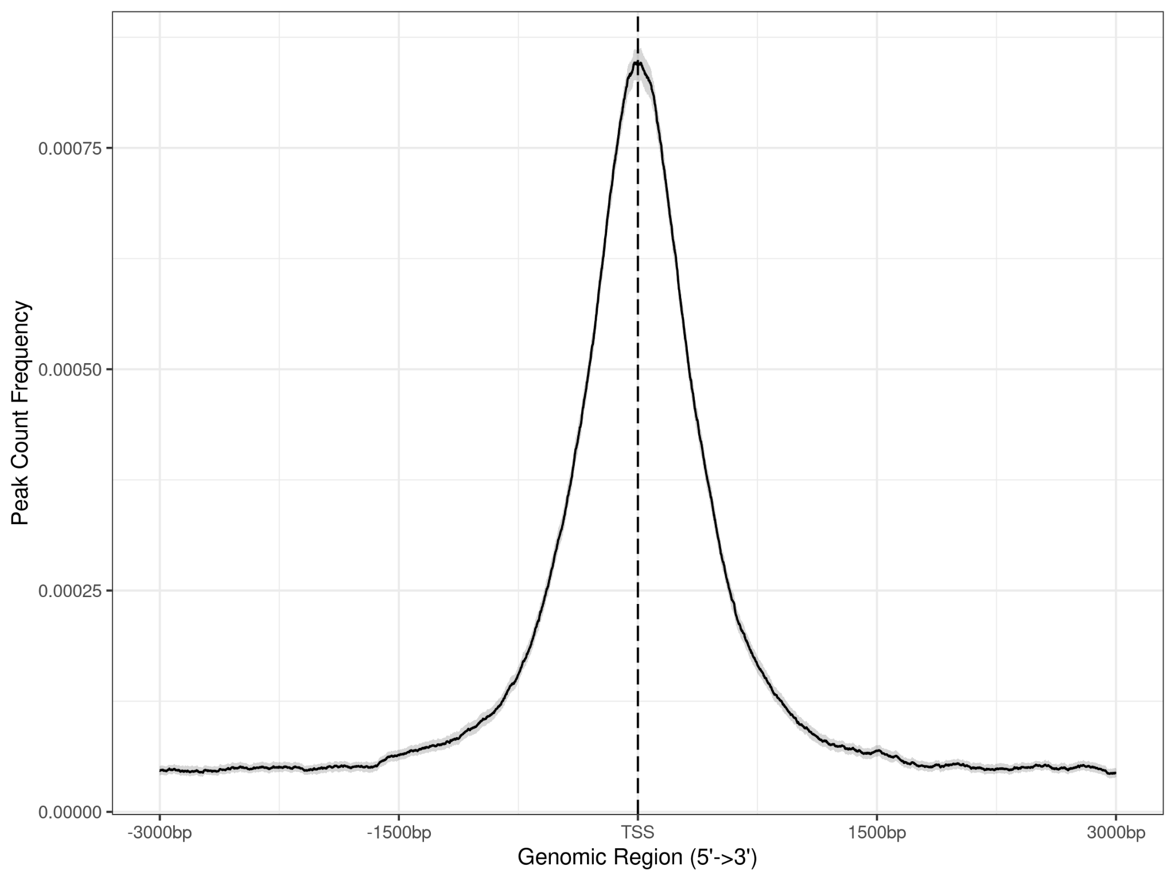
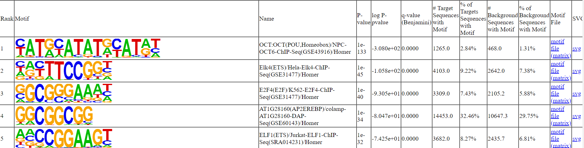
Progress so far
Next steps
ATF4 ChIP-seq data collection
Identified peaks, annotations and motifs for GPS2 and ATF4 separately under Stress and Differentiation conditions.
Look for overlaps between GPS2 and ATF4 binding regions.
Identify differential peak sets.
Gene Set Enrichment Analysis
Data collection and analysis for ATF3

Slide 9
Objectives
Implications
Identify genes co-occupied by different TFs and cofactors.
Compare the specific genomic locations where the factors are recruited.
Explore whether GPS2 recruitment is mediated by one or many of the ATFs.
To understand the basis of adaptive responses towards the maintenance of metabolic homeostasis.
Possible effects for studies on mitochondrial diseases and metabolic syndromes, aging and cancer.

Slide 10
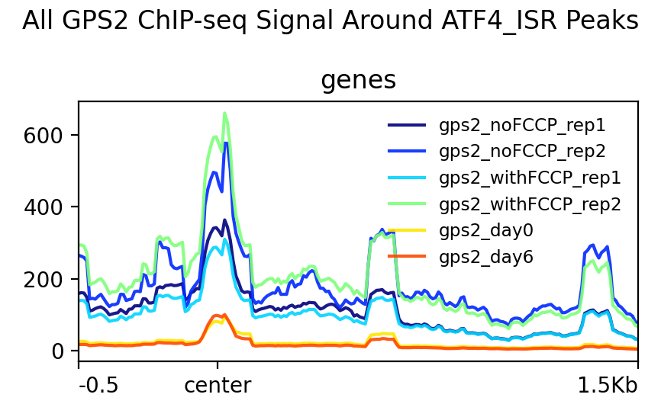

Slide 11




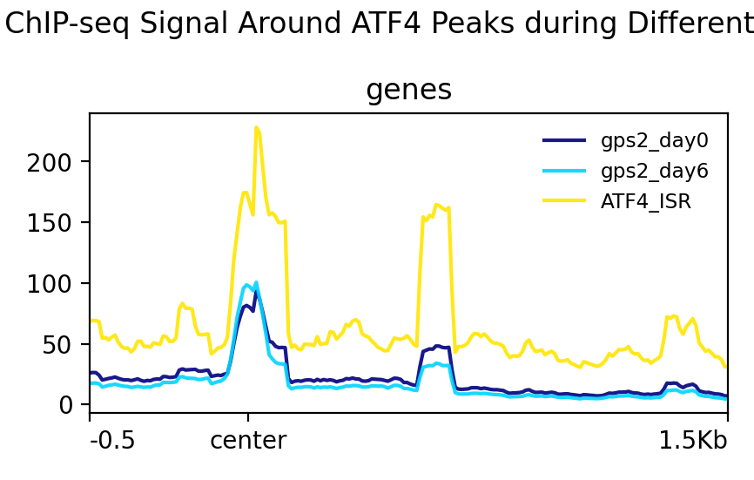
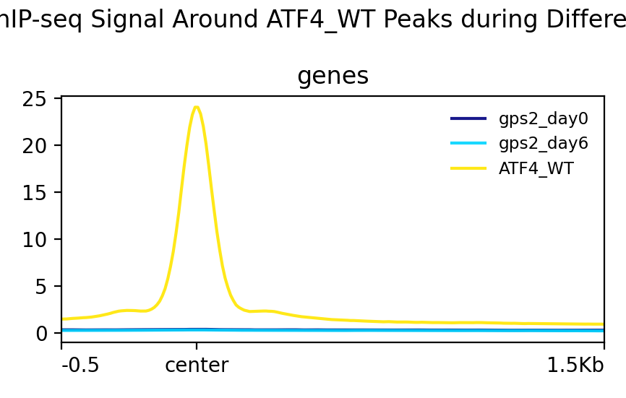
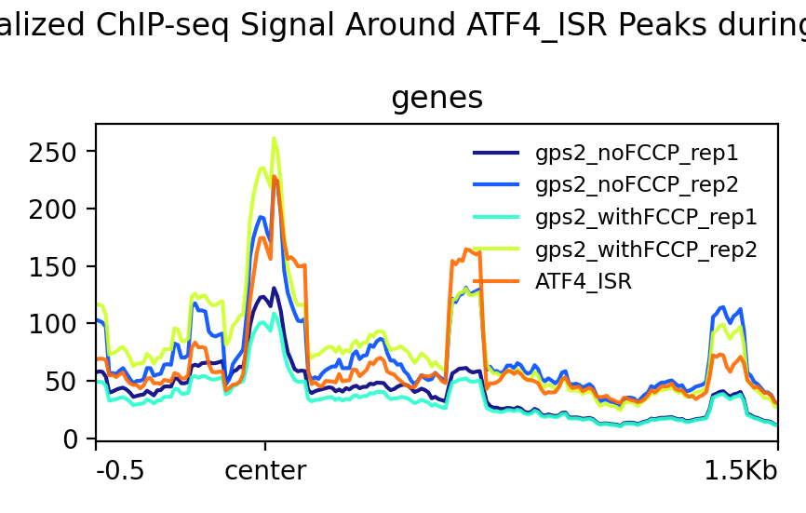
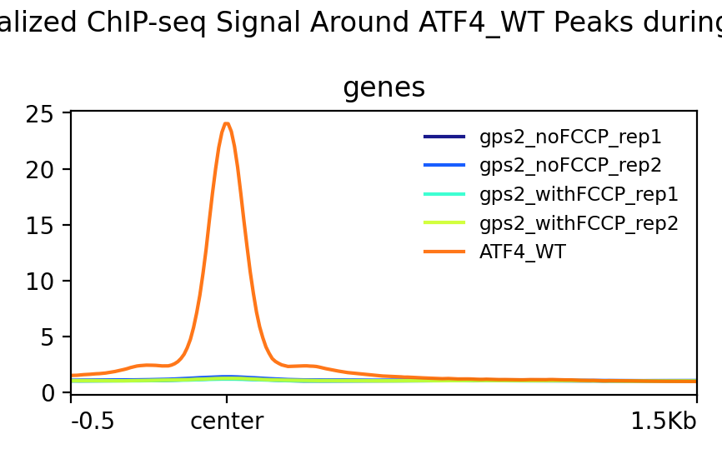
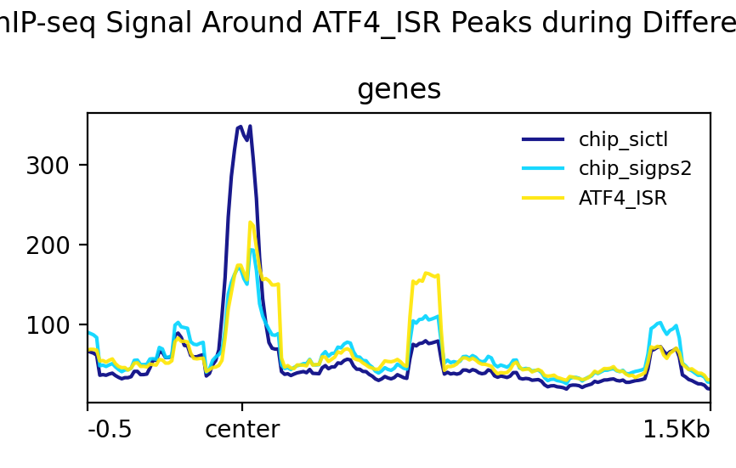
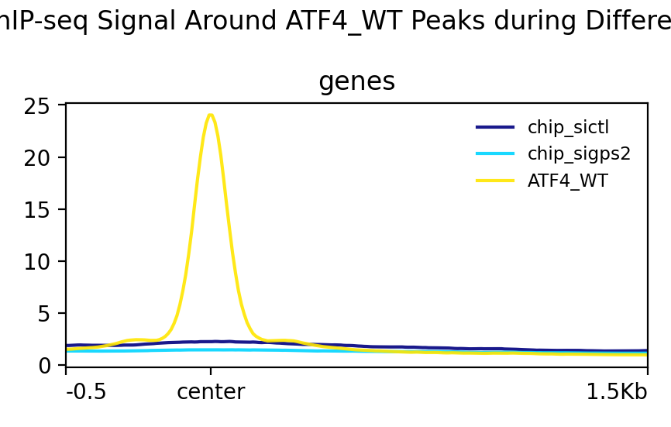
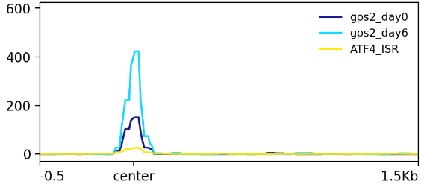
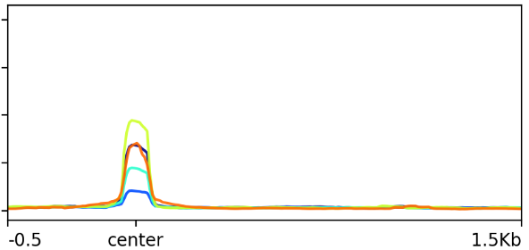
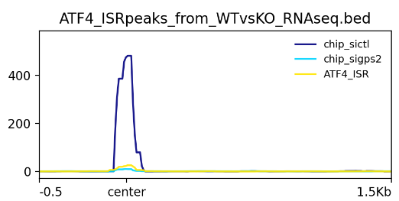
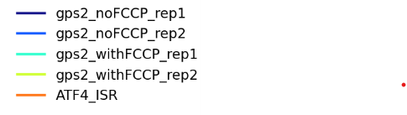
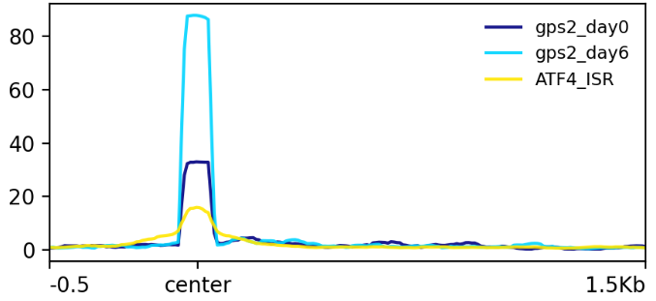
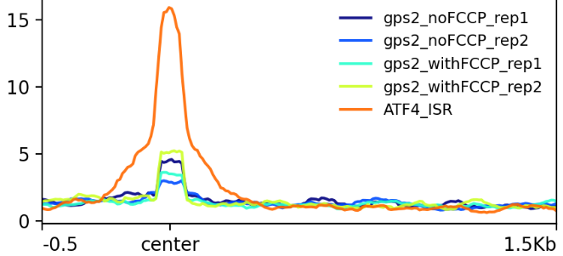
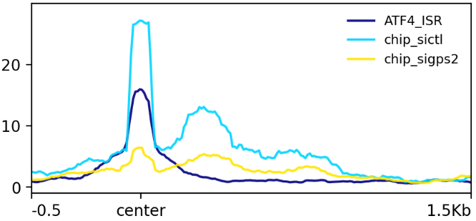
Exploring GPS2 and ATF4 Crosstalk in Mitochondrial Stress Response
Github
Contact
Jawahar Mahendran¹, Valentina Perissi² and Joseph Orofino³
1. Masters Student, Bioinformatics, Faculty of Computing and Data Science, Boston University
2. Department of Biochemistry and Cell Biology, Chobanian and Avedisian School of Medicine, BUSM
3. Faculty of Computing and Data Science, Bioinformatics, Boston University
Abstract
Methodology
Results
Conclusion
Table 1: Overlap of ATF4 and GPS2 Peaks across different conditions with percentages indicating the predominant peak annotations.
Figure 1: Plot Profiles of GPS2 and ATF4 Signals Across Different Conditions This figure presents the plot profiles of GPS2 and ATF4 signals, segmented by experimental conditions. Each plot centers on ATF4 peaks, allowing for a comparison of signal intensities and distributions relative to ATF4 binding sites. The profiles illustrate how GPS2 binding behavior varies across the different conditions, revealing the interaction between GPS2 and ATF4 under specific cellular contexts.
The analysis of peak overlaps between ATF4 and GPS2 under varying conditions provides valuable insights into their interplay, particularly within the context of mitochondrial stress and cellular differentiation. The consistent overlap of peaks between ATF4 in the amino acid-deprived state (AAD) and GPS2 during differentiation, coupled with the prominent enrichment of mitochondrial UPR pathways in the GSEA results, suggests a coordinated role for GPS2 and ATF4 in mediating stress and differentiation responses. The lack of overlap between ATF4 in AAD and GPS2 under mitochondrial stress induced by FCCP is surprising, especially given the detectable GPS2 signals in the plot profiles (Table 1 and Figure 2a). Furthermore, the observed increase in peak intensity for GPS2 on day 6 compared to day 0, aligned with RNA-seq data^{[3,4]}, reinforces the notion of GPS2's dynamic regulation during differentiation. Collectively, these findings highlight GPS2's potential role in modulating ATF4 activity in response to cellular stress and differentiation, with a particular emphasis on mechanisms associated with the mitochondrial UPR.
Mitochondrial function requires precise coordination between mitochondrial and nuclear genomes. This study focuses on GPS2 (G-protein Pathway Suppressor 2), a key mediator of mitochondrial retrograde signaling. We hypothesize that GPS2 is recruited to nuclear stress response genes through interactions with the transcription factors ATF3, ATF4, and ATF5. Through the integration of ChIP-seq data, we have identified key co-regulated genes, indicating a coordinated role for GPS2 and ATF4 in regulating mitochondrial stress responses, with evidence suggesting potential direct interactions between GPS2 and ATF4.
 | ATF4
GPS2 | Amino Acid Deprivation (ATF4_ISR) (525) | ER Stress (ATF4_WT) (20639)
GPS2_day0 (11917) | 387 Distal intergenic(50%) | 266 Promoter(83%)
GPS2_day6 (44523) | 378 Distal intergenic(51%) | 691 Promoter(76%)
GPS2_withFCCP (2623) | 0 | 10 Promoter(40%)
GPS2_siCTL (10059) | 111 Distal intergenic(40%) | 301 Promoter(95%)
Adipocyte - Differentiation
Differentiation
Treatment
2. Mitochondrial Stress
Wild-type
Table 2: Representative GSEA results of the overlapping peaks from MSIGDB
Gene Set Enrichment
HALLMARK UNFOLDED PROTEIN RESPONSE
HALLMARK_MTORC1_SIGNALING
HALLMARK INTERFERON GAMMA RESPONSE
HALLMARK PI3K AKT MTOR SIGNALING
HALLMARK APICAL SURFACE
HALLMARK_UV_RESPONSE_UP
3. GPS2-silencing
Introduction
Mitochondria depend on the nuclear genome for most of their proteome, requiring precise coordination of gene expression via anterograde and retrograde signaling pathways. GPS2 plays a crucial role in retrograde signaling, especially under mitochondrial stress^{[1]}. It is hypothesized that GPS2 interacts with bZIP transcription factors such as ATF3, ATF4, and ATF5, which are integral to stress response pathways, including the mitochondrial unfolded protein response (mtUPR)^{[2]}. Understanding GPS2's recruitment mechanisms with these transcription factors could be essential for understanding mitochondrial stress responses and has implications for metabolic diseases, aging, and cancer.
Figure 2: Plot Profiles of GPS2 and ATF4 Signals Across Conditions upon comparison with ATF4-RNA seq data
This figure presents the plot profiles of GPS2 alongside ATF4_ISR (Amino Acid Deprivation) signals, segmented by experimental conditions. Each plot is centered on ATF4 peaks associated with differentially expressed genes identified from RNA-seq experiments. The profiles illustrate the variability in GPS2 binding behavior across different conditions, with a specific focus on genes that are differentially expressed under conditions similar to those in the GPS2 experiments.
GPS2 conditions
RNA-seq conditions
Differentiation
Mitochondrial Stress
GPS2-silencing
References
ER stress through Tunicamycin
Cardamone MD, Tanasa B, Cederquist CT, et al. Mitochondrial Retrograde Signaling in Mammals Is Mediated by the Transcriptional Cofactor GPS2 via Direct Mitochondria-to-Nucleus Translocation. Mol Cell. 2018;69(5):757-772.e7. doi:10.1016/j.molcel.2018.01.037
Melber A, Haynes CM. UPRmt regulation and output: a stress response mediated by mitochondrial-nuclear communication. Cell Res. 2018;28(3):281-295. doi:10.1038/cr.2018.16
Margaret E Torrence, Michael R MacArthur, Aaron M Hosios, Alexander J Valvezan, John M Asara, James R Mitchell, Brendan D Manning (2021) The mTORC1-mediated activation of ATF4 promotes protein and glutathione synthesis downstream of growth signals eLife 10:e63326
Fusakio, M. E., Willy, J. A., Wang, Y., Mirek, E. T., Al Baghdadi, R. J., Adams, C. M., Anthony, T. G., & Wek, R. C. (2016). Transcription factor ATF4 directs basal and stress-induced gene expression in the unfolded protein response and cholesterol metabolism in the liver. Molecular biology of the cell, 27(9), 1536–1551. https://doi.org/10.1091/mbc.E16-01-0039
mTORC1 signaling (Growth Differentiation)

Slide 12
GPS2 and ATF4 Peak overlaps
 | ATF4
 | Overlap = 83
GPS2 | Amino Acid Deprivation (ATF4_ISR) (525) | ER Stress (ATF4_WT) (20639) | ATF4 common (ATF4_ISR on ATF4_WT) (83)
GPS2_day0 (11917) | 387 Distal intergenic(50%) | 266 Promoter(83%) | 8
GPS2_day6 (44523) | 378 Distal intergenic(51%) | 691 Promoter(76%) | 5
GPS2_withFCCP (2623) | 0 | 10 Promoter(40%) | 0
GPS2_siCTL (10059) | 111 Distal intergenic(40%) | 301 Promoter(95%) | 2

Slide 13

ATF4_ISR over GPS2_FCCP (Treatment) ATF4_ISR over GPS2_Differentiation
ATF4_ISR over GPS2_Silencing

Slide 14
ATF4_WT over GPS2_FCCP (Treatment) ATF4_WT over GPS2_Differentiation
ATF4_WT over GPS2_Silencing

Slide 15
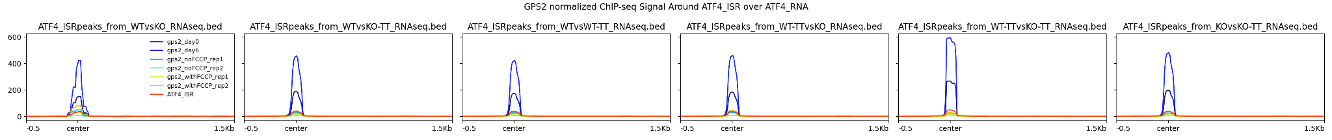
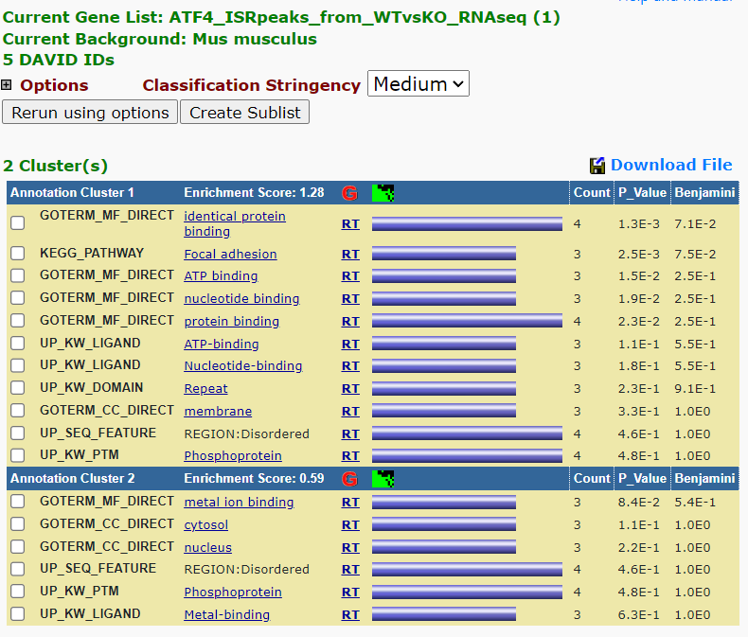
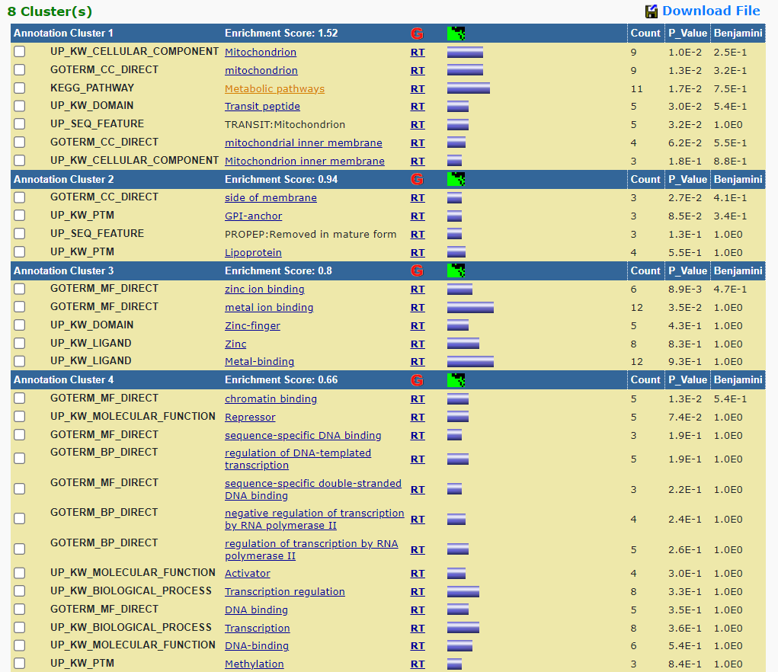
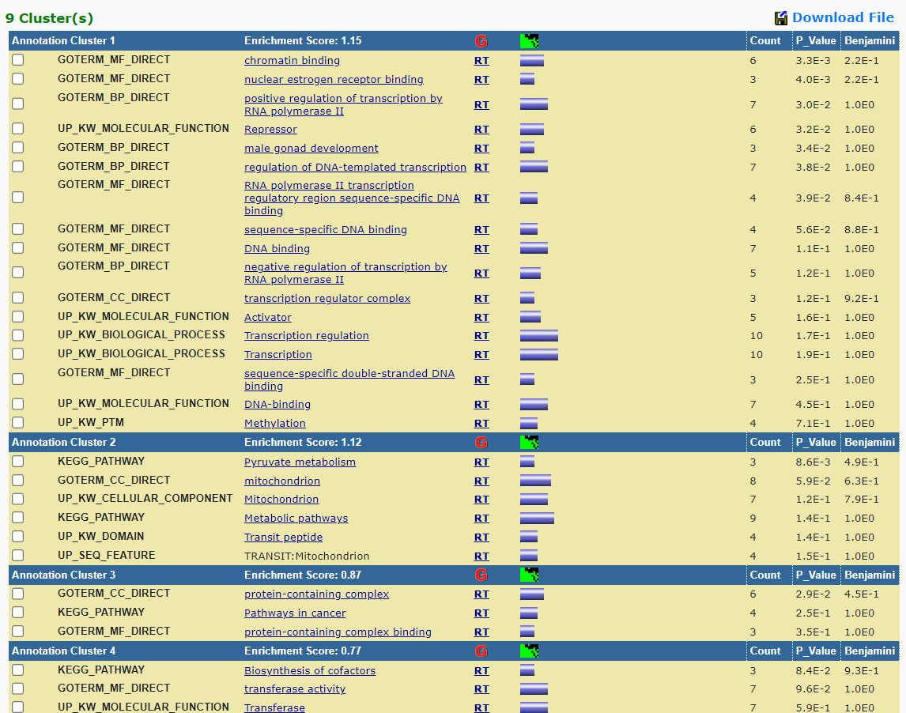
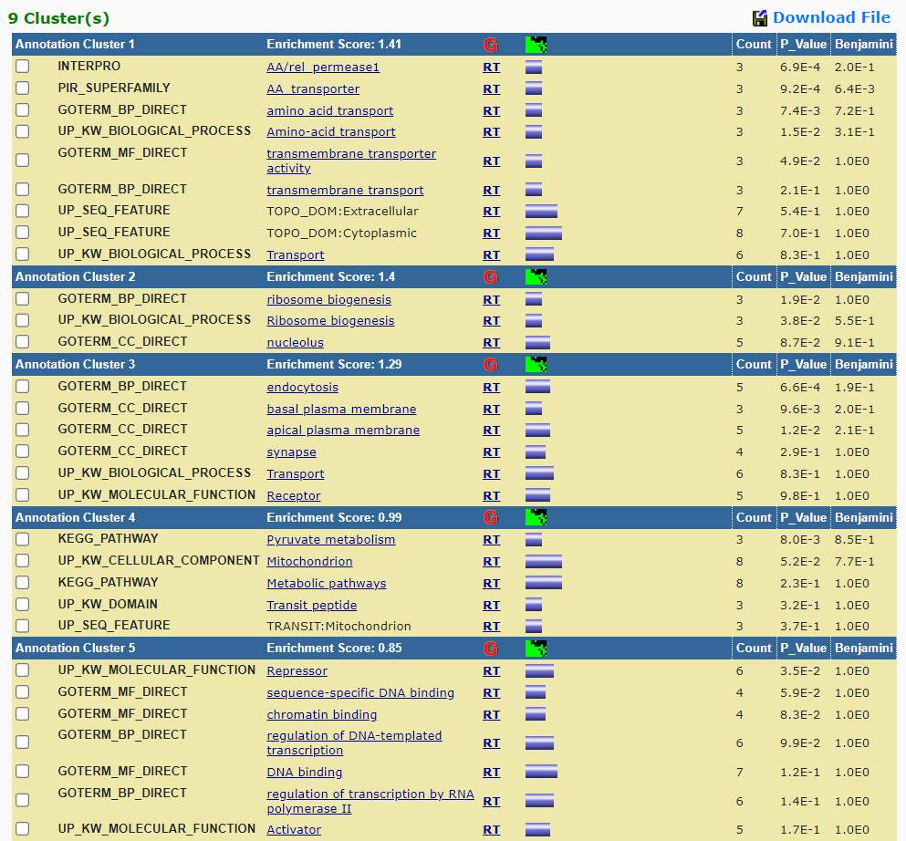
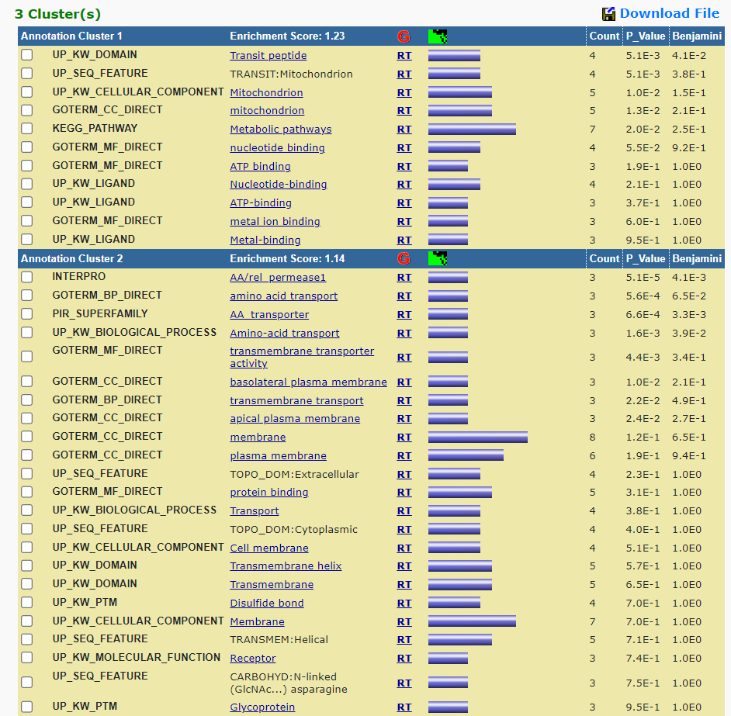
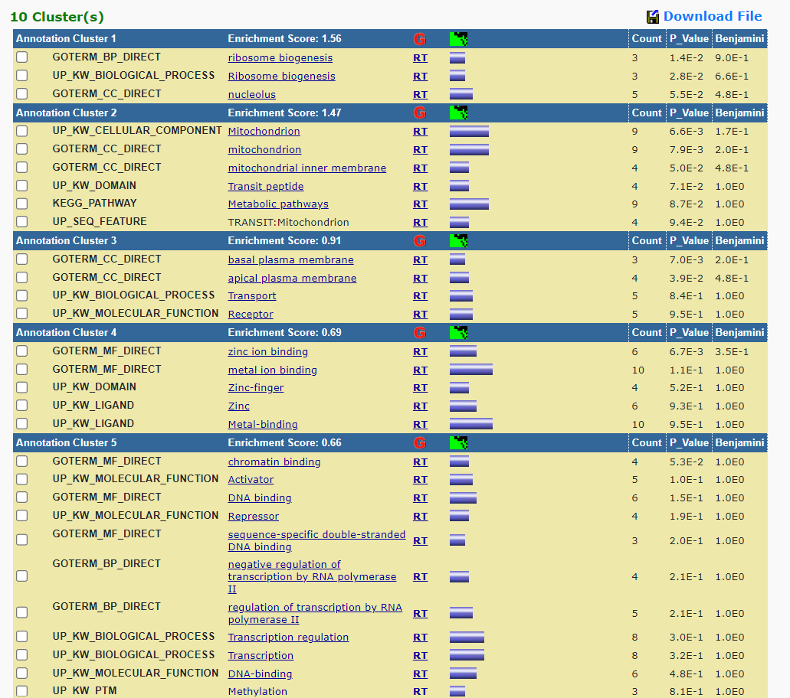
GPS2 signal over ATF4_ISR peaks from RNA-seq (26960794)
5 52 58 57 16 49

Slide 16
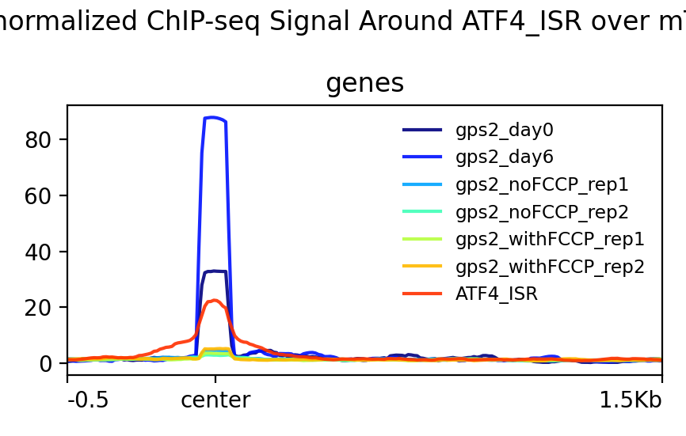
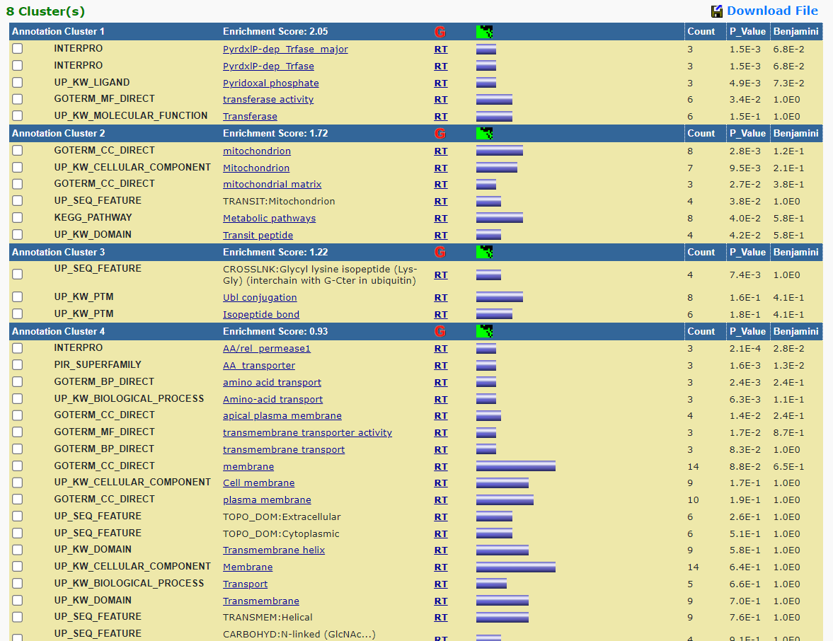
GPS2 signal over ATF4_ISR peaks from mTORC1 RNA-seq(33646118)
33

Slide 17
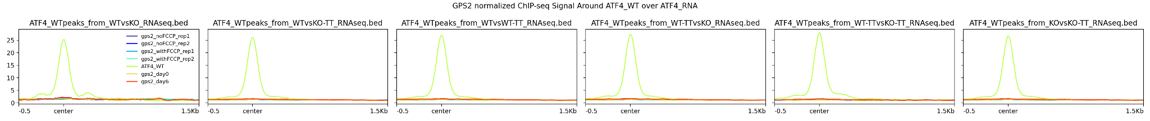
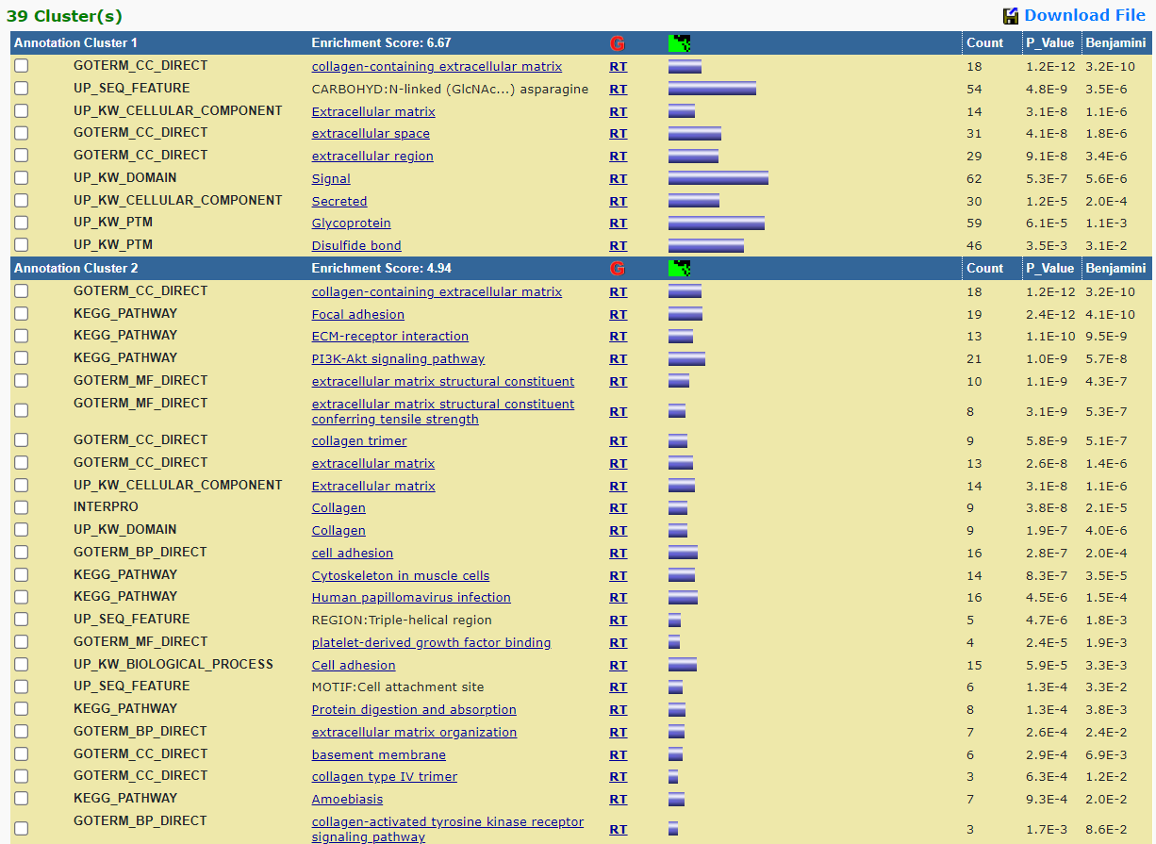
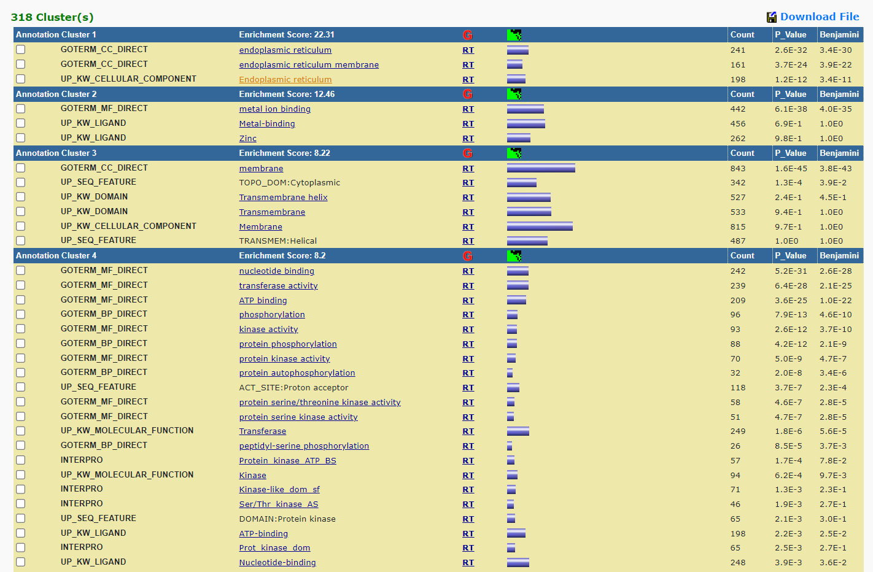
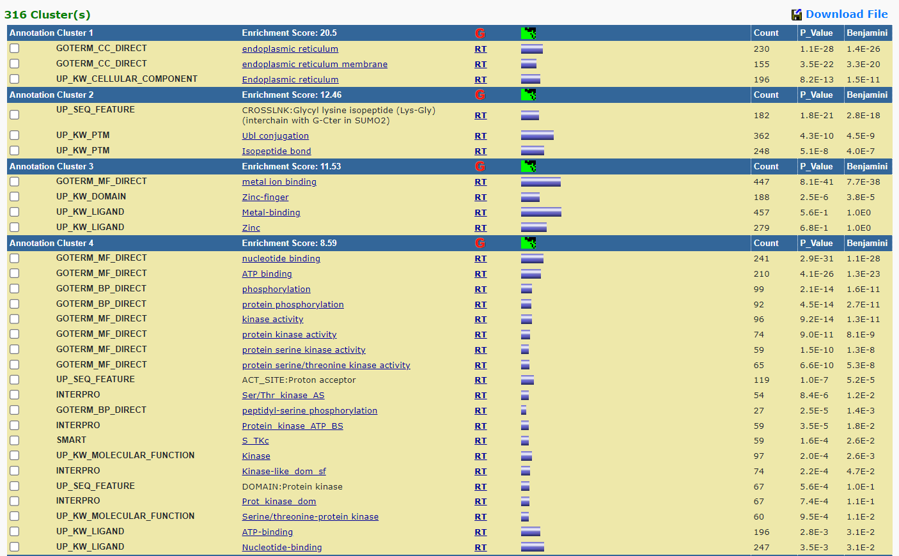
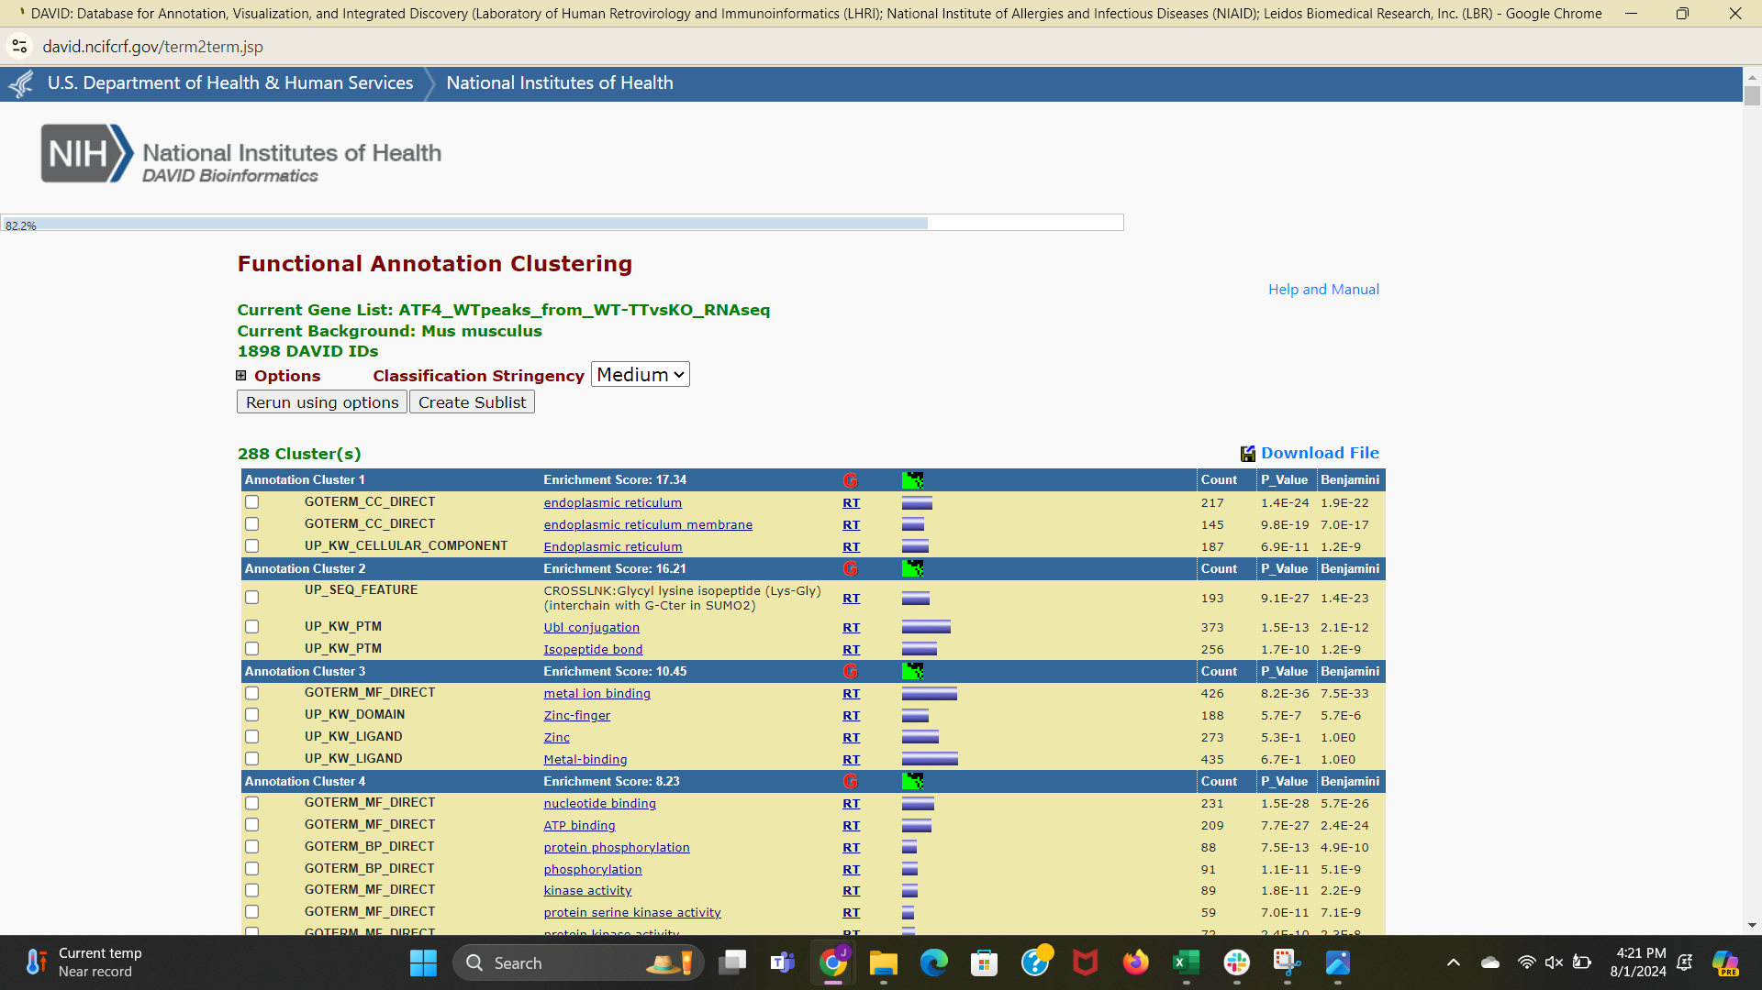
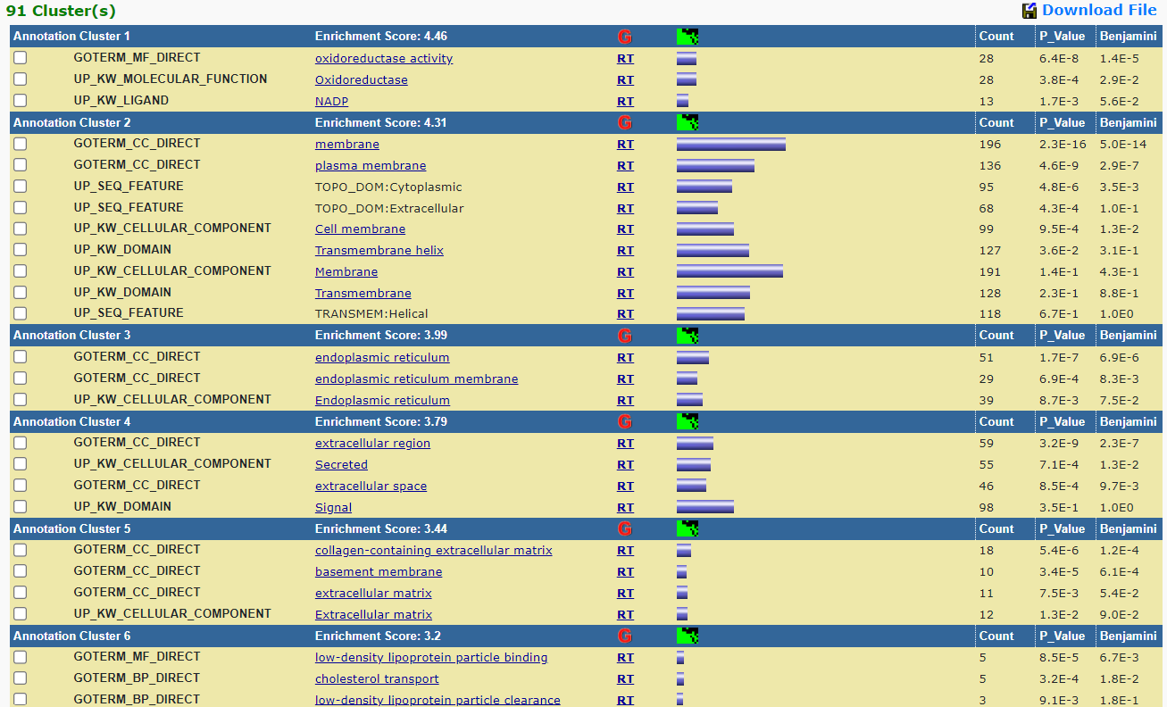
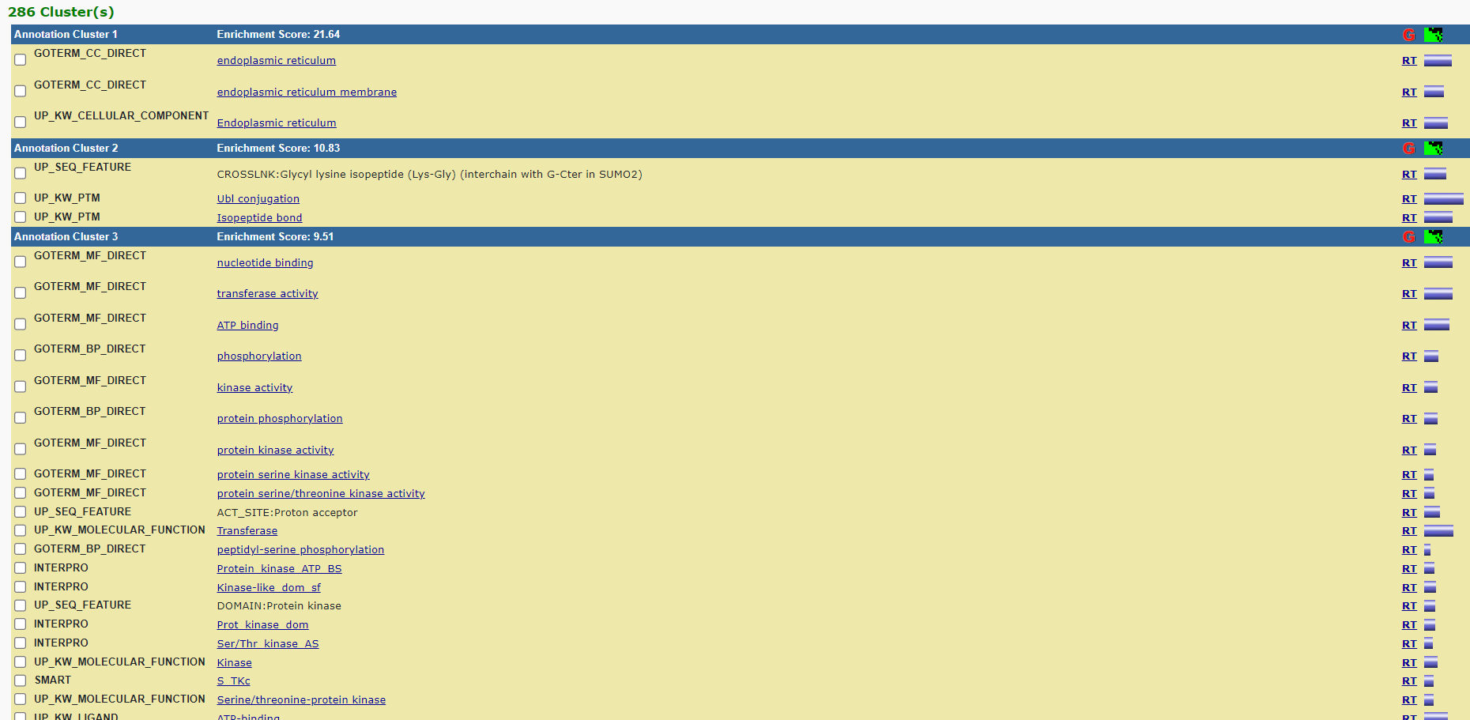
GPS2 signal over ATF4_WT peaks from RNA-seq (26960794)
150 1953 1929 1896 410 1832

Slide 18
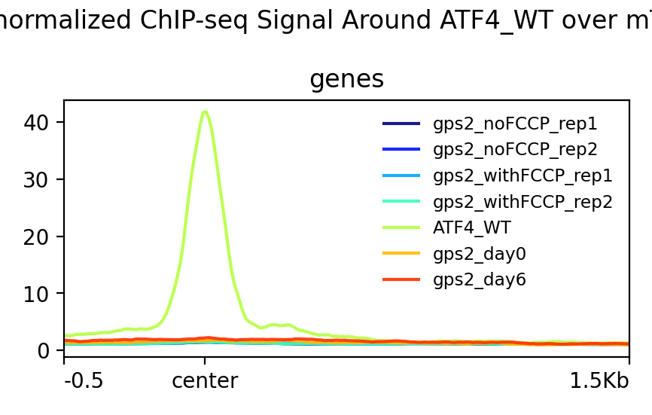
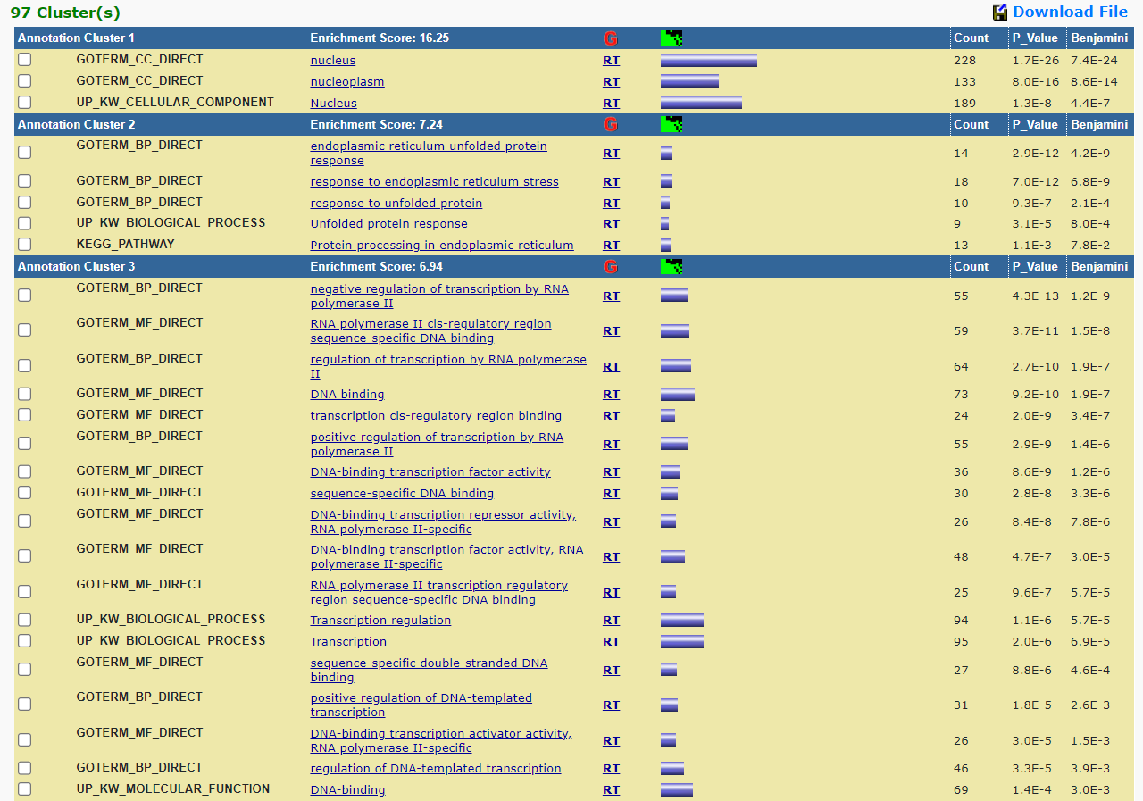
GPS2 signal over ATF4_WT peaks from mTORC1 RNA-seq(33646118)
543

Slide 19
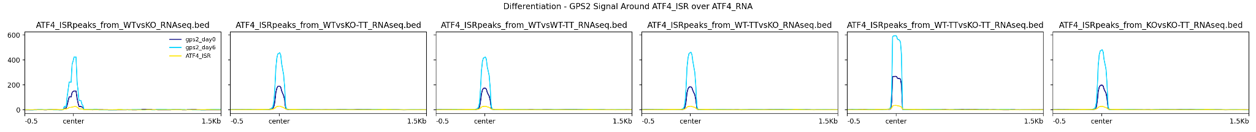
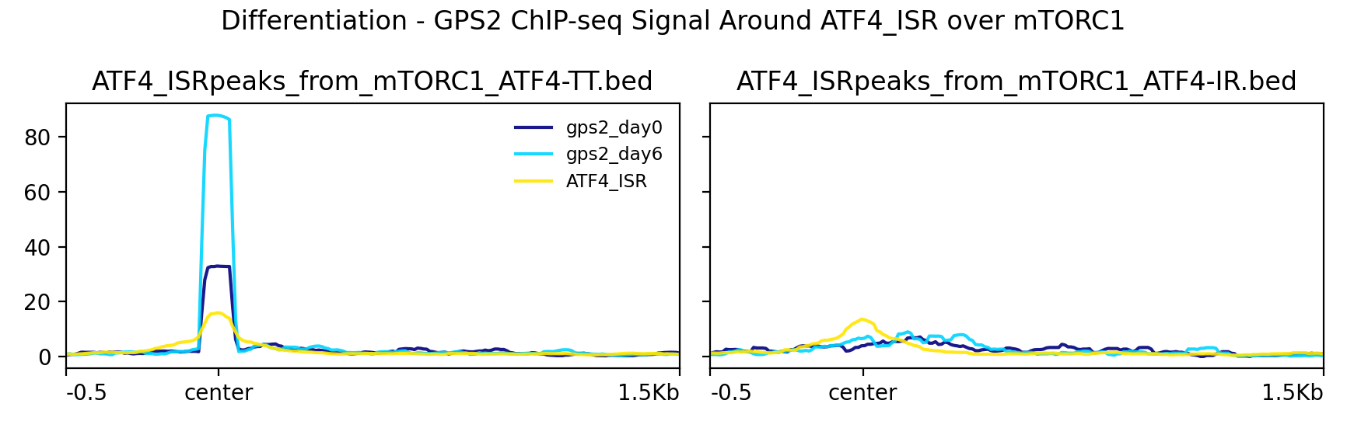
GPS2: Differentiation; ATF4: Amino Acid Deprivation
Comparison of GPS2 Differentiation Conditions and ATF4_ISR Peaks with ATF4 Genes Dysregulated by Tunicamycin-Induced ER Stress
Comparison of GPS2 Differentiation Conditions and ATF4_ISR Peaks with ATF4 Genes Dysregulated by Tunicamycin and Insulin-Rapamycin

Slide 20
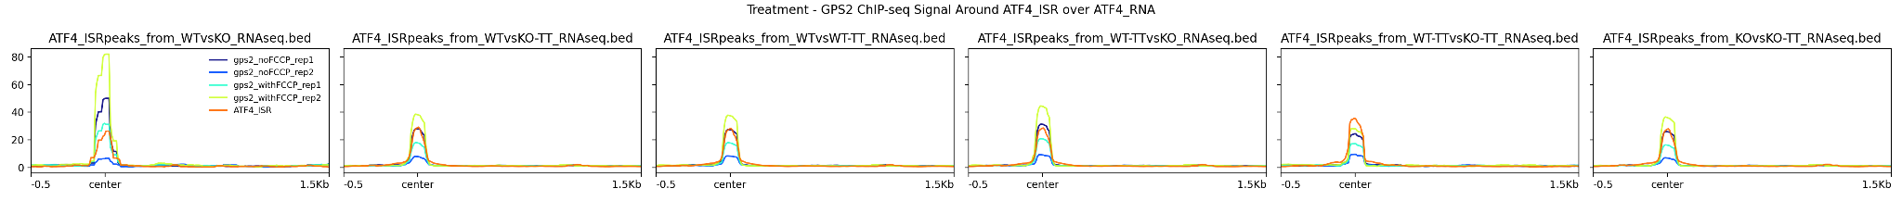
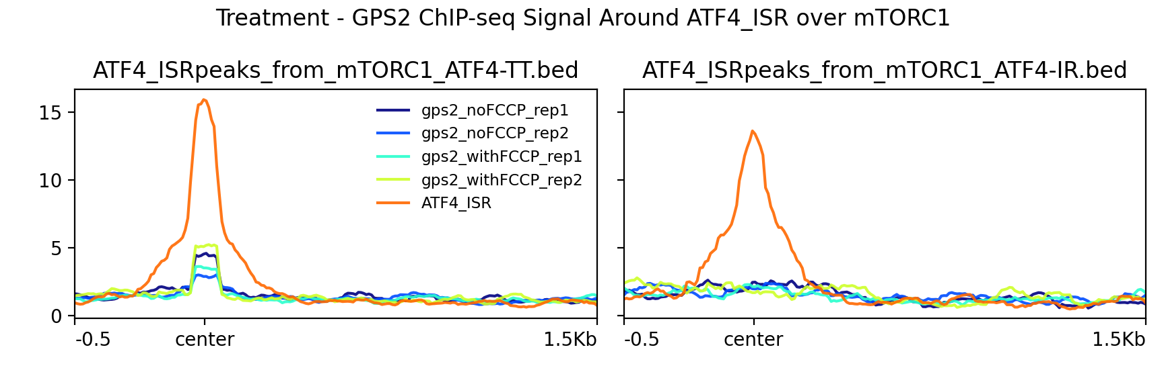
GPS2: Treatment; ATF4: Amino Acid Deprivation
Comparison of GPS2 Treatment Conditions(with/no FCCP) and ATF4_ISR Peaks with ATF4 Genes Dysregulated by Tunicamycin-Induced ER Stress
Comparison of GPS2 Treatment Conditions(with/no FCCP) and ATF4_ISR Peaks with ATF4 Genes Dysregulated by Tunicamycin and Insulin-Rapamycin

Slide 21
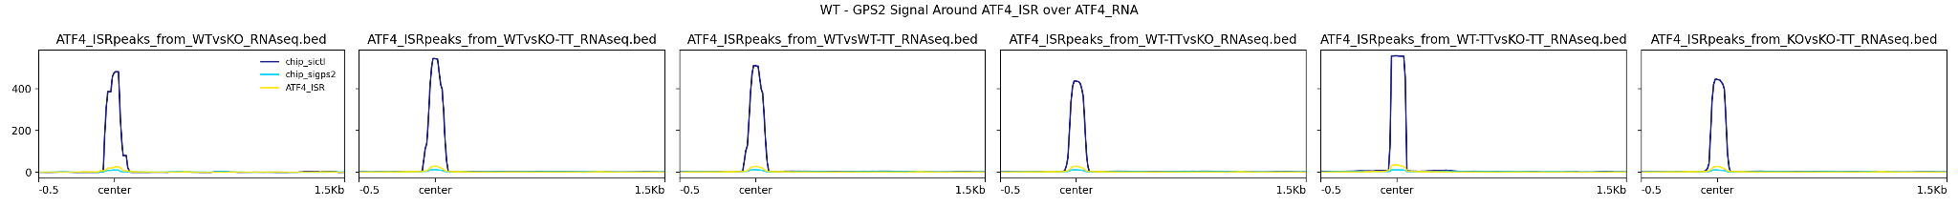
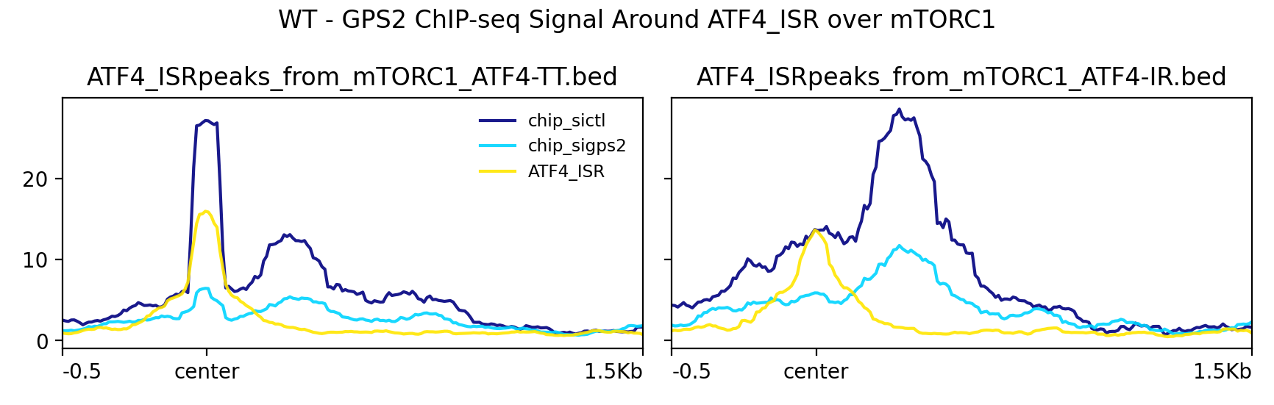
GPS2: Wild Type; ATF4: Amino Acid Deprivation
Comparison of siGPS2, siCTL and ATF4_ISR Peaks with ATF4 Genes Dysregulated by Tunicamycin-Induced ER Stress
Comparison of siGPS2, siCTL and ATF4_ISR Peaks with ATF4 Genes Dysregulated by Tunicamycin and Insulin-Rapamycin

Slide 22
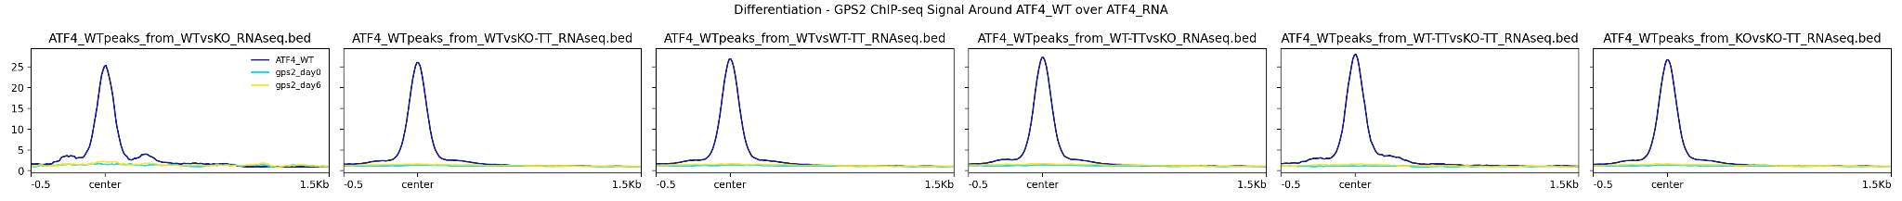
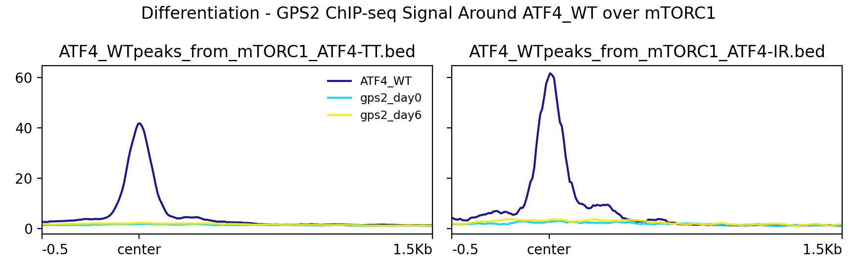
GPS2: Differentiation; ATF4: Tunicamycin treated
Comparison of GPS2 Differentiation Conditions and ATF4_WT Peaks with ATF4 Genes Dysregulated by Tunicamycin-Induced ER Stress
Comparison of GPS2 Differentiation Conditions and ATF4_WT Peaks with ATF4 Genes Dysregulated by Tunicamycin and Insulin-Rapamycin

Slide 23
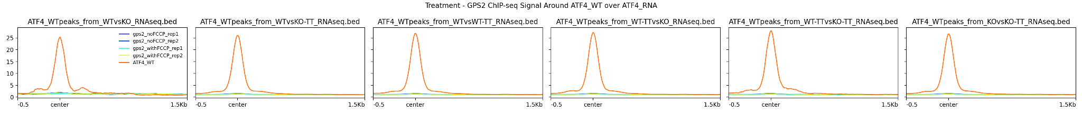
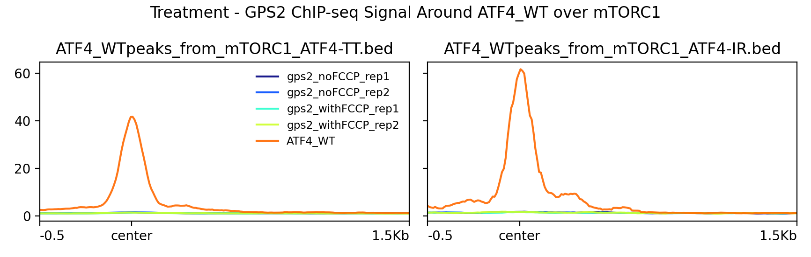
GPS2: Treatment; ATF4: Tunicamycin treated
Comparison of GPS2 Treatment Conditions(with/no FCCP) and ATF4_WT Peaks with ATF4 Genes Dysregulated by Tunicamycin-Induced ER Stress
Comparison of GPS2 Treatment Conditions(with/no FCCP) and ATF4_WT Peaks with ATF4 Genes Dysregulated by Tunicamycin and Insulin-Rapamycin

Slide 24
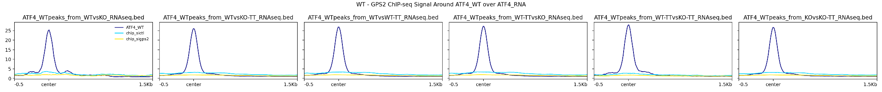
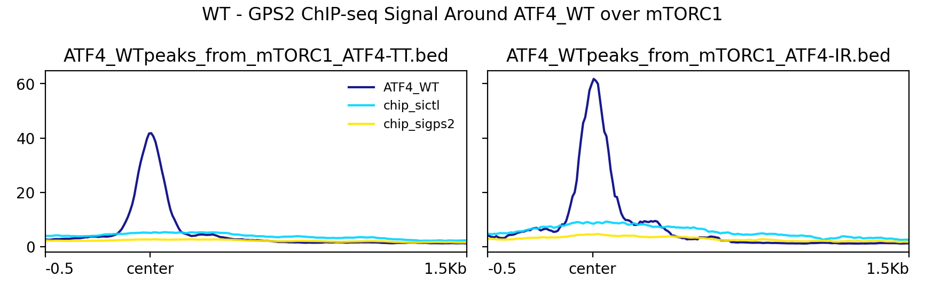
GPS2: Wild Type; ATF4: Tunicamycin treated
Comparison of siGPS2, siCTL and ATF4_WT Peaks with ATF4 Genes Dysregulated by Tunicamycin-Induced ER Stress
Comparison of siGPS2, siCTL and ATF4_WT Peaks with ATF4 Genes Dysregulated by Tunicamycin and Insulin-Rapamycin

Slide 25
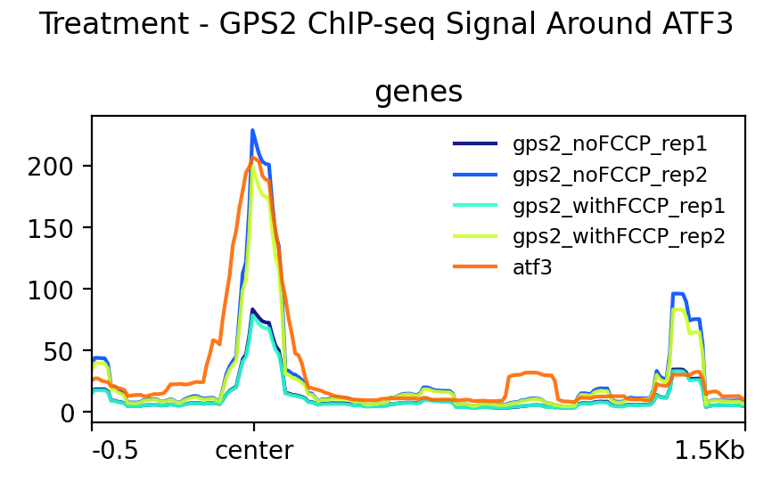
GPS2: Treatment; ATF3: Wild-type

Slide 26

GPS2: Wild-type; ATF3: Wild-type

Slide 27

GPS2: Differentiation; ATF3: Wild-type

Slide 28
GPS2 and ATF3 Peak overlaps
GPS2 C2C12 | ATF3 (324) | ATF3_from_paper (2871)
90 (3497) | 7 | 26
3hr (1372) | 6 | 11
d2 (366) | 8 | 26
d4 (2102) | 1 | 6

Slide 29


Just ATF3 with ATF3 peaks centered
GPS2 and ATF3 with ATF3 peaks centered

Slide 30


Slide 31

ATF4_WT(Tmc) with Multiomic analysis (RNA-seq)
0 overlaps with ATF4_ISR (Amino acid deprived)

Slide 32


Slide 34
Peak Overlaps
 | ATF4
GPS2 | ATF4_AAD (1385) | ATF4_WT_Tmc (45633) | ATF4_KO_Tmc (7483) | ATF4_WT_Tmc_vs_ATF4_KO_Tmc (20639)
gps2_day0 (11917) | 933 Distal Intergenic - 52.21% | 1642 Promoter - 70.19% | 1407 Distal Intergenic - 41.77% | 266 Distal Intergenic - 83.09%
gps2_day6 (44523) | 927 Distal Intergenic - 51.99% | 3031 Promoter - 73.5% | 1603 Promoter - 39.66% | 691 Promoter - 76.55%
gps2_day6_vs_gps2_day0 (1220) | 57 Distal Intergenic - 50% | 42 Promoter - 80.6% | 92 Distal Intergenic - 42.6% | 16 Promoter - 93.75%
gps2_noFFCP (874114) | 945 Distal Intergenic - 46.32% | 2964 Promoter - 32.02% Distal Intergenic - 30.55% | 10562 Promoter - 33.89% Distal Intergenic - 31.16% | 3902 Distal Intergenic - 32.35%
gps2_withFCCP (693709) | 980 Distal Intergenic - 47.49% | 15771 Promoter - 31.76% Distal Intergenic - 30.9% | 3538 Promoter - 36.48% | 5955 Distal Intergenic - 33.19%
gps2_withFCCP_vs_gps2_noFCCP (2623) | 22 Distal Intergenic - 100% | 33 Distal Intergenic - 33.33% | 20 Distal Intergenic - 66.67% | 10 Distal Intergenic - 40%
sictl (35541) | 783 Distal Intergenic - 43.84% | 4874 Promoter - 79.01% | 1641 Promoter - 53.59% | 1267 Promoter - 82.09%
sigps2 (65315) | 788 Distal Intergenic - 54.39% | 4622 Promoter - 76.68% | 1724 Promoter - 49.16% | 1186 Promoter - 78.67%
sictl_vs_sigps2 (10059) | 218 Distal Intergenic - 33.33% | 1338 Promoter - 94.57% | 381 Promoter - 75.81% | 301 Promoter - 95.68%

Slide 35



ATF4:Amino acid deprivation

Slide 36



ATF4:ER Stress

Slide 37



RNA-seq comparisons
RNA-seq: Tunicamycin treatment (26960794) ; ATF4: Amino Acid Deprivation

Slide 38



RNA-seq comparisons
RNA-seq: Tunicamycin treatment (26960794) ; ATF4: ER stress

Slide 39



RNA-seq comparisons
RNA-seq: mTORC1 (33646118) ; ATF4: Amino acid deprivation

Slide 40



RNA-seq comparisons
RNA-seq: mTORC1 (33646118) ; ATF4: ER stress

Slide 41



RNA-seq comparisons
RNA-seq: Multiomics (28566324) ; ATF4: Amino acid deprivation

Slide 42



RNA-seq comparisons
RNA-seq: Multiomics (28566324) ; ATF4: ER stress

Slide 43



RNA-seq comparisons
RNA-seq: Multiomics (28566324) ; Across TSS

Slide 44



RNA-seq comparisons
RNA-seq: Alzheimers(36867706) ; Across TSS

